Slide 1

Pawesome
PAWESOME
Samudrala nikitha
192011225
cse
BY:
SAMUDRALA NIKITHA
192011225

Slide 2

Project includes
Introduction (Appium & Android Studio)
Objective
Applications used
Code Implementation
Appium Testing
Outcome

Slide 3

abstract
Install Android Studio , IntelliJ and Appium Softwares.
Develop Pawesome Application in Android Studio.
Open pawesome in Emulator.
Give Desired Capabilities in Appium Server.
Get the Java code and HTML code for Testing.
Paste the code in IntelliJ IDE.
Run the code and Test the Conversions and Parameters.

Slide 4

introduction
Open source Automation tool.
Automation Framework.
Automates different types of mobile
applications testing.
It can test web , Native and Hybrid application.
It supports multiple programming languages.(Java , python , ruby and many more )
It works on Emulator as well as Real Devices.

Slide 5

Introduction
It is Integrated development Environment.
It has fast Emulator for App Testing.
Used to Develop applications for Android devices.
It is an open source software.
Android Studio

Slide 6

Objective
To Develop Pawesome application using Android Studio and Run the application using Android Studio Emulator.
Installing The Appium Software and Testing the pawesome Application using the Appium Software.

Slide 7

Test cases
APP LAUNCH
USER NAME
SEARCH
BREEDS
TEMPAMENT
HEIGHT
WEIGHT
LIFE SPAN
PERFORMANCE

Slide 8

Proposed Work
To Develop Scientific pawesome Application.
Run the Application using Android Studio Emulator.
Test the Application in Appium Software.
Appium will Automate the Testing of Application.
Appium interacts with the Application and finds the positive and Negative Outcomes.
Different Strategies Will be tested using Appium.

Slide 9



Applications Used
APPIUM
INTELLIJ
ANDROID STUDIO

Slide 10

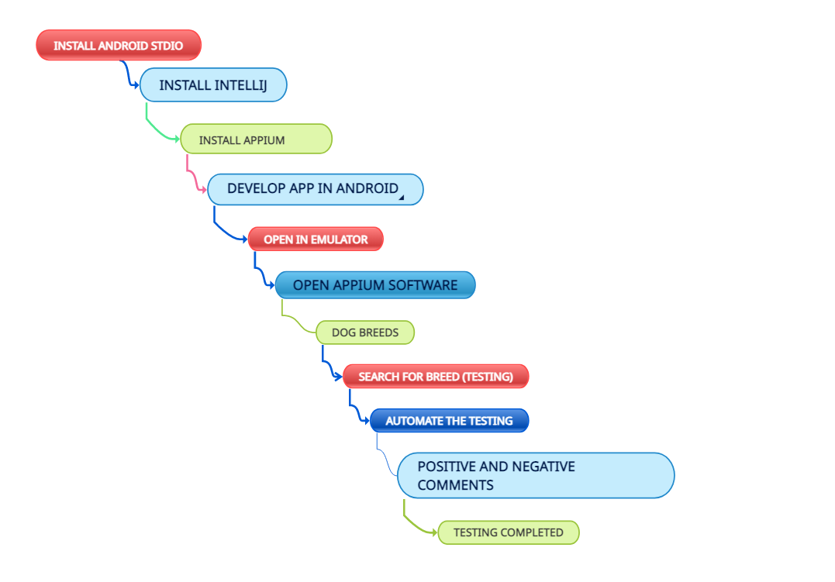
DATA FLOW DIAGRAM

Slide 11

TEST CASE (OUTCOME)
APP LAUNCH -- POSITIVE
USER NAME -- POSITIVE
SEARCH -- POSITIVE
BREEDS -- POSITIVE
TEMPAMENT -- POSITIVE
HEIGHT -- POSITIVE
WEIGHT -- POSITIVE
LIFE SPAN -- POSITIVE
PERFORMANCE -- POSITIVE

Slide 12
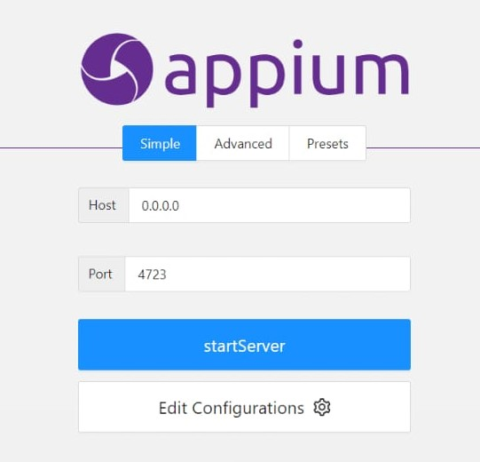
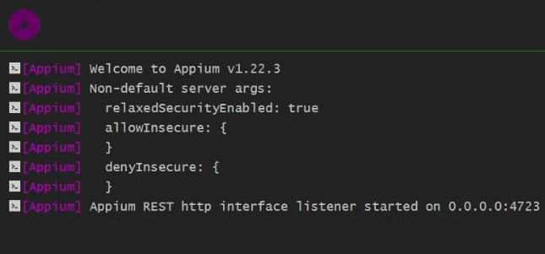
Appium Server
Before starting server
After starting Server

Slide 13
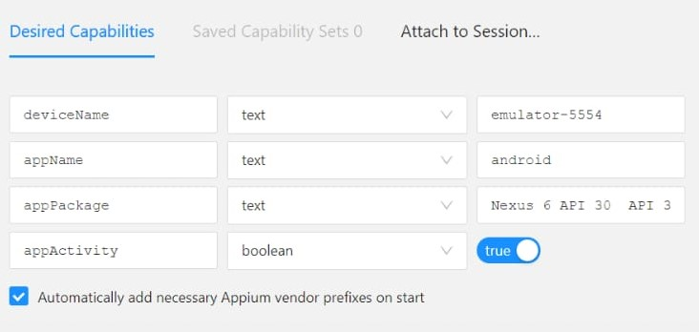
Appium Inspector (Desired Capabilities)
Give the Desired Capabilities in Appium Inspector.
It will start the session and gives you java code to start testing.
Paste the code in IntelliJ IDE and Start the Testing.

Slide 14
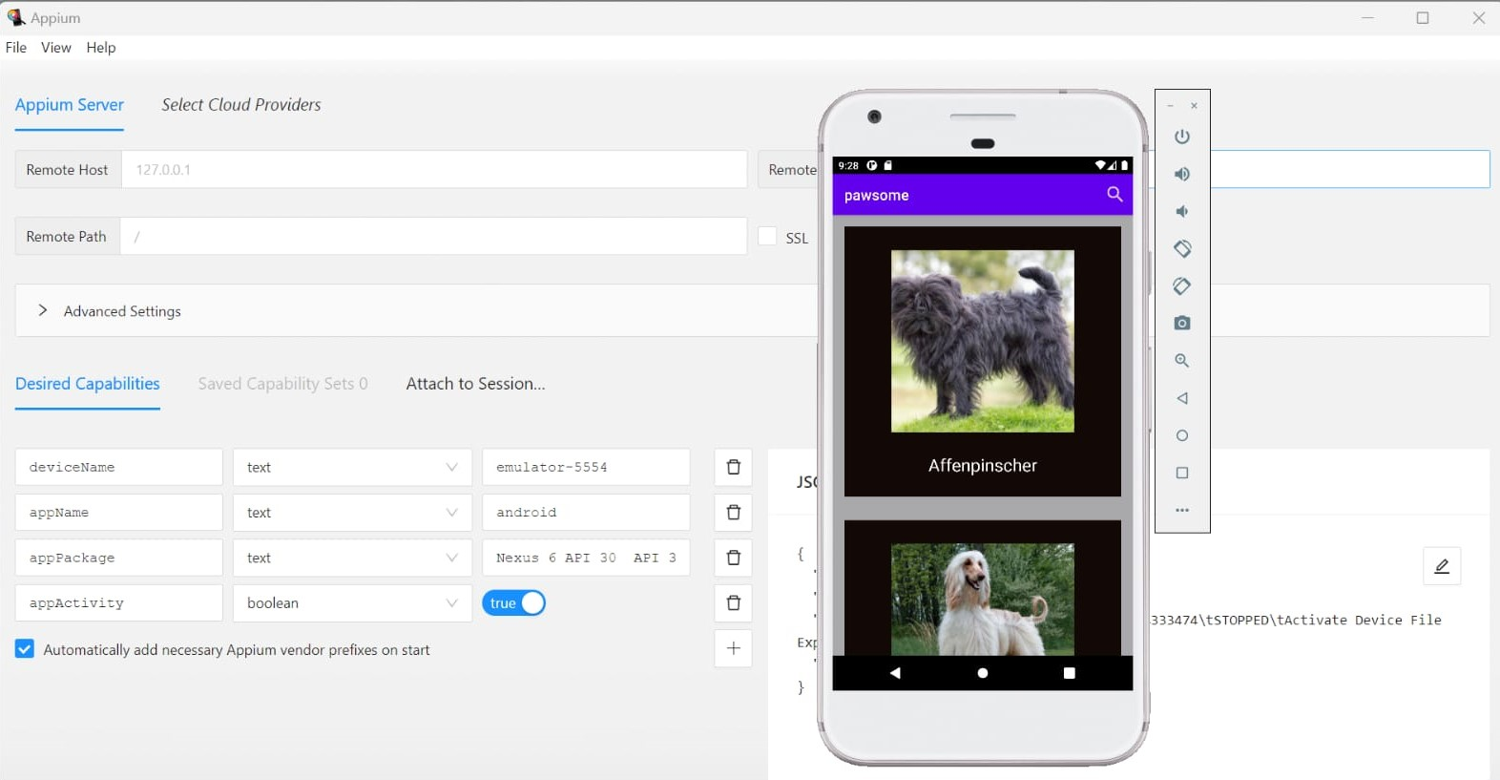
Testing output

Slide 15
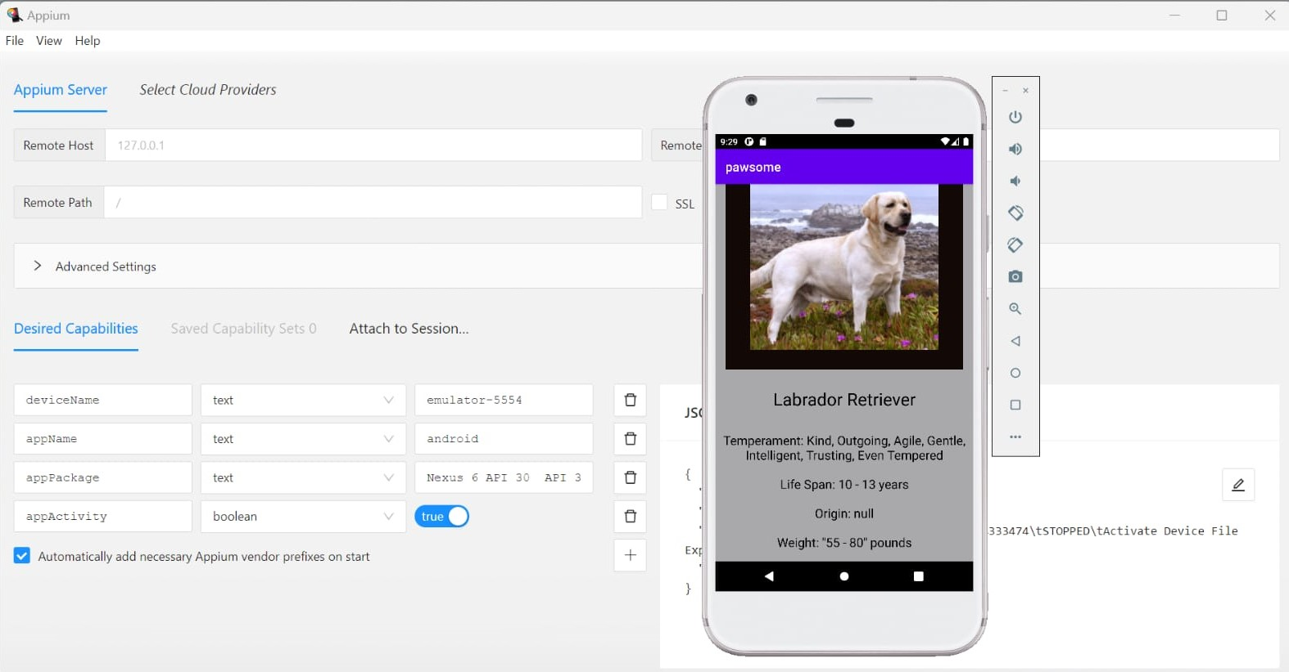
Testing output

Slide 16


